Slide 1
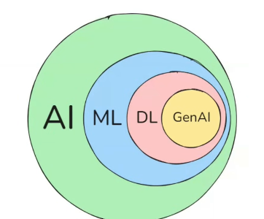

π
Gradient Descent
Neural Network
Gradient Descent
Problem with RNN
Gradient Descent
LSTM
Loss /Cost Function
Learning Rate
Relu
TanH
Sigmoid
feed forward NN
Notes:
Content: https://www.linkedin.com/pulse/chunking-strategies-ai-data-kash-kashyap-0lghe/

Slide 2
Gradient Descent
It is an algorithm
Let try to understand it with an Example. suppose you are my friend and going to attend an mathematics test
in Mathematics | Test Max Marks=50
After exam done, you come to me and ask me how much mark I get I said - 40
Then you say no man 40 is too much.
Then again I guess and said 30,
Then you say no man 30 is too less.
Then i say 34, then you said "you are very close to answer"
Guess
This is exact how gradient descent work internally
40
30
34
So in Gradient Descent we start with a random guess, then we slowly move to the right answer or the best answer
40 ↓ -10
30 ↓ +5
35 ↓
Gradient Descent Purpose
Minimize the cost function, which measures prediction error.
Notes:
Content: https://www.linkedin.com/pulse/chunking-strategies-ai-data-kash-kashyap-0lghe/

Slide 3
So the Common formula for Parameter optimization in gradient descent look like as below
New Value = Old Value - Step Size
How much you want to move or shift
New value is updated version of old value adjusted against something this is called Stepsize
This stepsize in world of gradient descent in term of mathematical formula is known as "Learning Rate*Slope"
Learning Rate*Slope
Notes:
Content: https://www.linkedin.com/pulse/chunking-strategies-ai-data-kash-kashyap-0lghe/

Slide 4
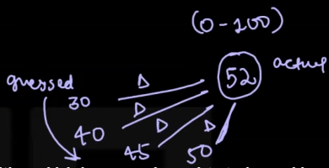
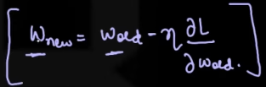
Example-1
Suppose I guessed a number, say 52. ​​Then I asked you to guess which number I had chosen between 0 and 100. Suppose you said 30. That's quite far off.
There’s a difference between them, then you said 40, still quite a difference but less than before. Then you said, suppose 45, so the difference got even smaller. Then you said 50, and the difference got smaller again. I said, yeah, now you’re guessing totally right, that number is really close to what I was thinking.
So here, the error keeps getting smaller. That’s exactly what gradient descent does — it works to reduce the error between your actual value, which was 52, and your guessed value, meaning the predicted value.
Gradient descent helps to minimize the error between the actual and predicted values.

Slide 5
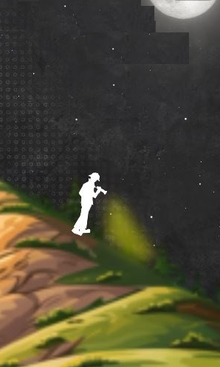
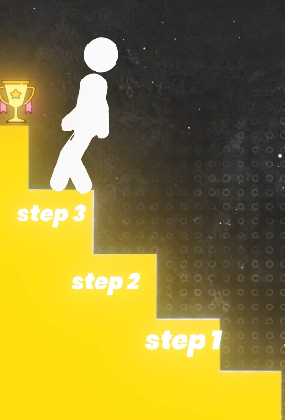
Example-2
Imagine you have to climb down a mountain at night. It’s dark, and you only have a torch that lights up just a small area around your feet. You move slowly, step by step, carefully checking the ground to avoid stones or pits. In this way, you eventually reach the bottom safely.
In machine learning, the gradient descent algorithm works in a similar manner. It takes small, gradual steps to minimize the loss function, guiding the model toward the best possible solution

Slide 6

Descent
नीचे (खाई की तरफ)
Iteration
==
[ Iteration /Error ]
# This GD algorithm is also called delta function
# GD is most used algorithm for training Neural Networks
This also an optimization algo. that is used to that minimize to cost/loss function by changing parameters
N​ew Value = Old Value - Slope x Learning Rate
= 2 - 2(x) x .1 2

Slide 7
Gradient Descent
▶
Gradient descent is an iterative optimization algorithm to find the minimum of a function. Here that function is our Loss Function.
▶
The main aim of gradient descent is to find the best parameters of a model which gives the highest accuracy on training as well as testing datasets and less error
Minimizing the cost function, loss function or error function:
The objective is to learn the values of parameters (aka feature weights) that minimize the cost function.
Most widely used optimization technique to minimize the loss is called the Gradient Descent.
Cost function
Model accuracy
Cost function
Model accuracy

Slide 8
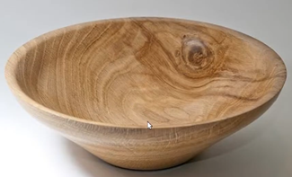
Intuition for Gradient Descent
▶
Think of a large bowl. This bowl is a plot of the cost function (E).
Y = mX + C
A random position on the surface of the bowl is the cost of the current values of the coefficients (cost).
The bottom of the bowl is the cost of the best set of coefficients, the minimum of the function.
The goal is to continue to try different values for the coefficients, evaluate their cost and select new coefficients that have a slightly better (lower) cost.
Repeating this process enough times will lead to the bottom of the bowl and u will know the values of the coefficients that result in the minimum cost

Slide 9
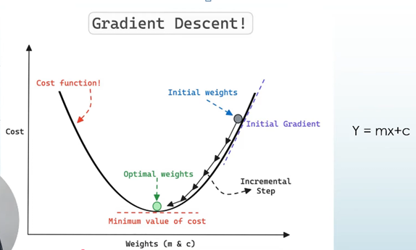

Slide 10
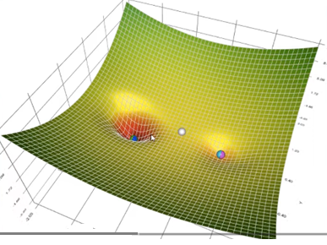
We change m and c parameter until the cost becomes 0 near to 0

Slide 11

Gradient Descent Procedure
➠
The procedure starts off with initial values for the coefficient or coefficients for the function. These could be 0.0 or a small random value.
coefficient(m.c) = 0.0
➠
The cost of the coefficients is evaluated by plugging them into the function and calculating the cost.
cost = E(coefficient)
Where m and c=0

Slide 12

➠
The derivative of the cost is calculated. The derivative is a concept from calculus and refers to the slope of the function at a given point. We need to know the slope so that we know the direction (sign) to move the coefficient values in order to get a lower cost on the next iteration.
➠
Now that we know from the derivative which direction is downhill, we can now update the coefficient values. A learning rate parameter (alpha) must be specified that controls how much the coefficients can change on each update.
This process is repeated until the cost of the coefficients (cost) is 0.0 or close enough to zero to be good enough.

Slide 13
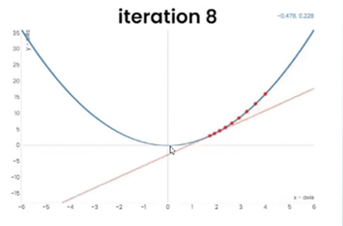
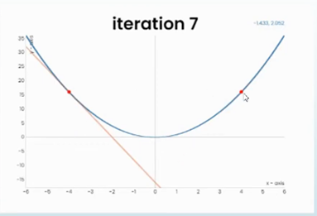
Very small learning Rate
Bounce back

Slide 14
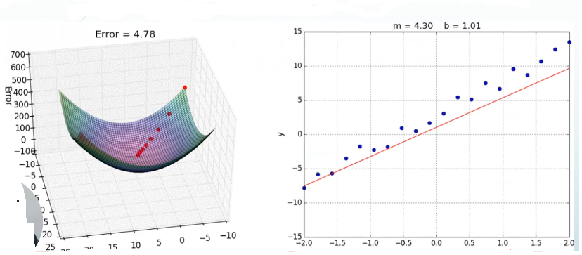
as cost function decrease, the line of best fit appears. Because we are moving down the hill by changing the values of m and c parameters using gradient descent

Slide 15
❯❯❯❯
Summary
Linear regression is about finding the line of best fit for a dataset. This line can then be used to make predictions
Gradient descent is a tool to arrive t the line of best fit
In Gradient descent, you start with a random line, then you change the parameter of the line(i.e. slope and y-intercept) little by little to arrive at the line of best fit

Slide 16
Linear Regression’s job is to find the line of best fit. Once that line is drawn, the cost function measures how much error is present.
The role of Gradient Descent is to act as a tool to arrive at the best‑fit line. Since the initial line from linear regression may still have some error, Gradient Descent says: “I will adjust the line step by step so that the error becomes as small as possible.”
✅ In short:
Linear Regression → finds the best‑fit line.
Cost Function → measures the error.
Gradient Descent → minimizes that error to refine the best‑fit line.

Slide 17
Types of Gradient Descent
Batch Gradient Descent
Stochastic Gradient Descent
Minibatch Gradient Descent

